Slide 1
Sumer

Slide 2
Mesopotamia - The Land Between Two Rivers
Mesopotamia was a place where many cities began to grow. As its name suggests, Mesopotamia was located between two rivers. The two rivers were the Tigris River and the Euphrates River.
Mesopotamia was located in the Middle East, and surrounded by desert. People came to Mesopotamia because the soil between the two rivers was very fertile.

Slide 3
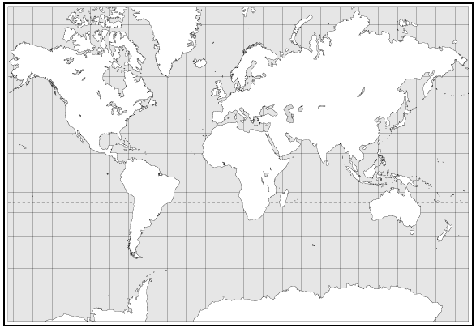
_{USA}
Mesopotamia was located in the Middle East.

Slide 4
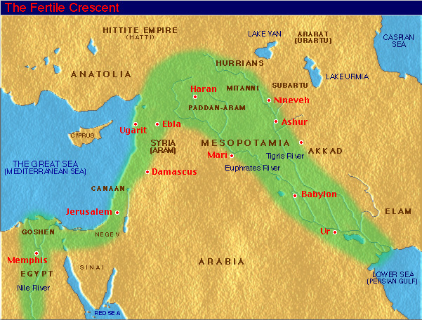

Slide 5
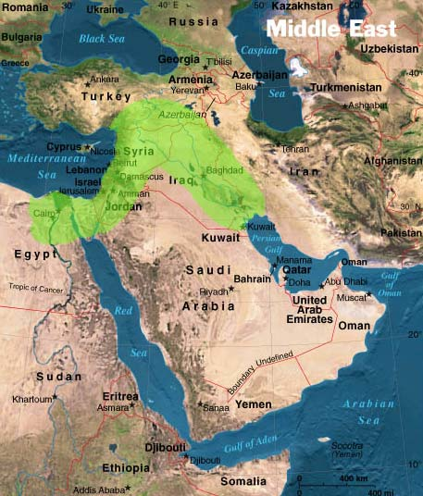
Mesopotamia was located in what is now the country of Iraq.

Slide 6
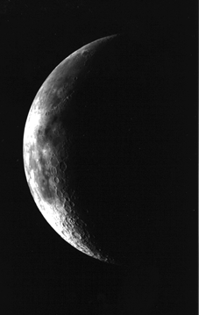
Mesopotamia was part of a larger region called the Fertile Crescent. This area, that stretched from the eastern edge of the Mediterranean Sea down to the Persian Gulf, had fertile soil and was where many civilizations started. The shape is somewhat similar to a crescent (think of a crescent roll, or a crescent-shaped moon).

Slide 7
The Cradle of Civilization
Mesopotamia is located in the Middle East, which is located in Southwest Asia. As we’ve discussed before, the first civilizations and examples of writing were found in Southwest Asia. These things began in Mesopotamia.
When a newborn baby begins life, he or she is placed in a cradle. Mesopotamia is called the cradle of civilization because the first civilizations began there, about 5,500 years ago in 3500 B.C.

Slide 8
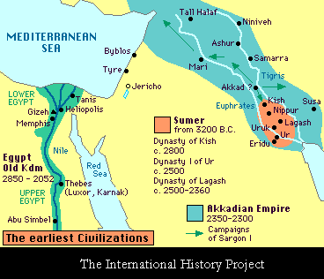
City-States Formed Along the Rivers
Many city-states formed along the Tigris and Euphrates Rivers in Mesopotamia. They each had their own form of government, and the people worshipped different gods and goddesses. Eventually, they each had their own kings. The region where the two rivers meet was called Sumer. The people who lived in the Sumer region were called Sumerians.

Slide 9
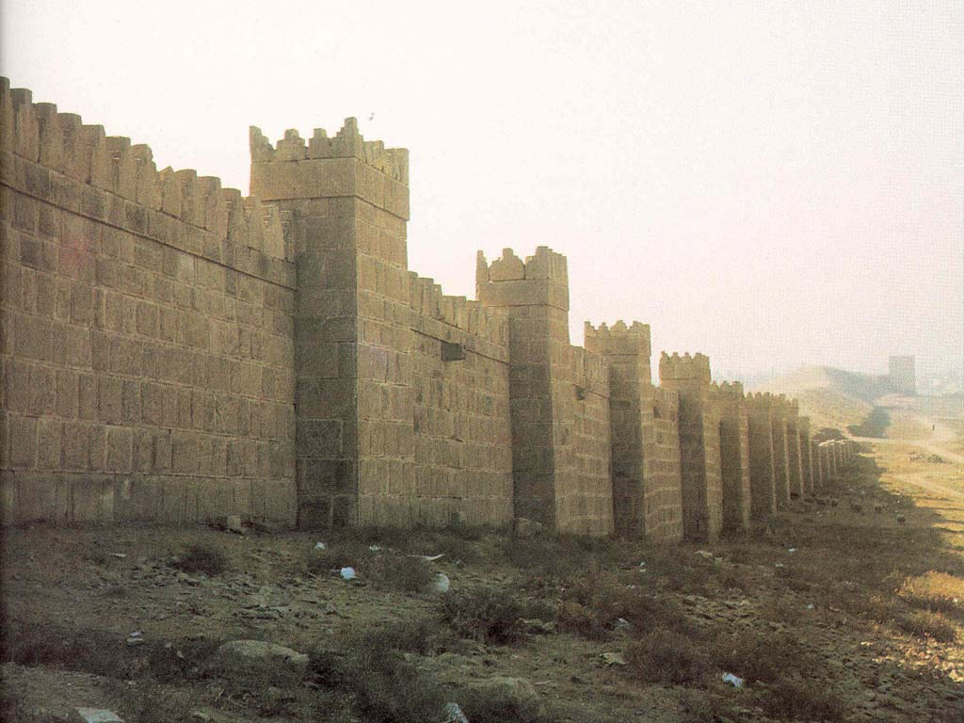
Why Did These Cities Develop?
Due to the fertile soil in Mesopotamia, farming was very successful. In fact, people were able to create surpluses of food. This meant that some people could stop farming and begin doing other things, like building a city.
As cities began to develop, people began to worry about others who might come and invade their city. They wanted to protect themselves from enemies, so people in Mesopotamia built walls around their cities.

Slide 10
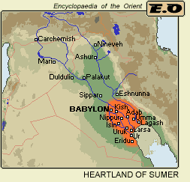
Sumerians
Writing first began in Sumerian cities. The first schools were set up in Sumer over 4,000 years ago. Sumerian schools taught boys the new invention of writing. Those who graduated became professional writers called scribes. Scribes were the only people who could keep records for the kings and priests. Boys that wanted to be scribes had to attend school from the age of 8 to the age of 20.
Remember, Sumer is the region where the Tigris and Euphrates Rivers meet.

Slide 11
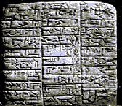
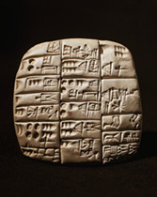
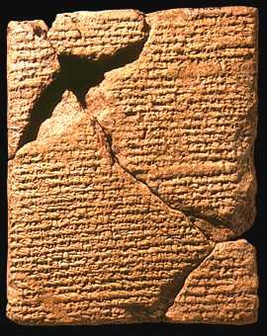
Sumerian Writing
Scribes used a sharp point called a stylus to etch words into clay tablets. These tablets have been discovered by archaeologists and looked at by historians.

Slide 12
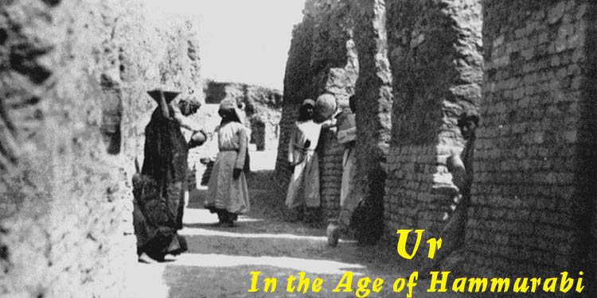
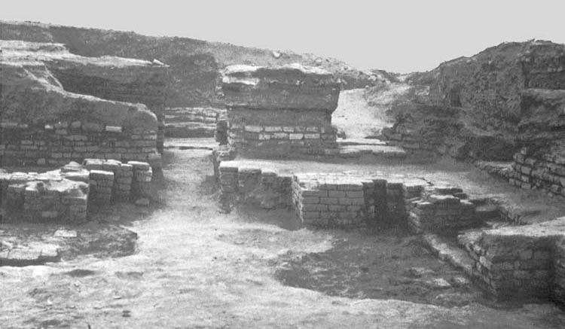
A Sumerian City
Sumerian city streets were so narrow that you could hardly get a cart through them.
Narrow Streets
Sumerian houses faced away from crowded streets. Instead, they faced onto courtyards where families ate and children played.
Courtyard Area

Slide 13
Sumerian Cities
On hot nights, people slept outdoors on the top of their house’s flat roof.
Sumerians had a form of light at night. They burned oil lamps.
Sumerians even had plumbing! Clay pipes that were buried underground carried their waste away. Inventions like plumbing wouldn’t come around for another thousand years in other parts of the world!

Slide 14
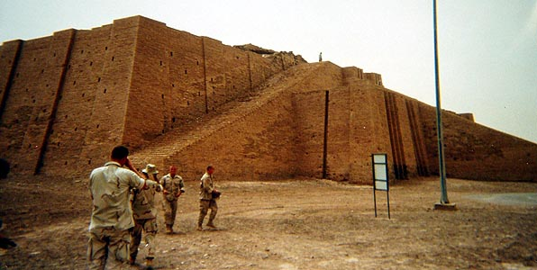
Sumerian Religion
Sumerians worshipped many gods, not just one. This belief in many gods is called polytheism. “Poly” means many and “Theism” means gods.
The picture above shows a ziggurat. Ziggurats were the main temples used to worship the gods of a city. Ziggurats were built in the center of the city. They had steps and ramps, and it was believed that the gods descended to the Earth using the ziggurat as a ladder.

Slide 15
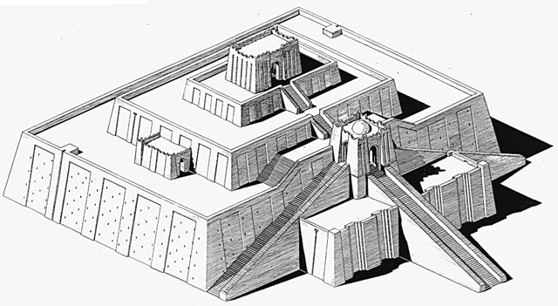
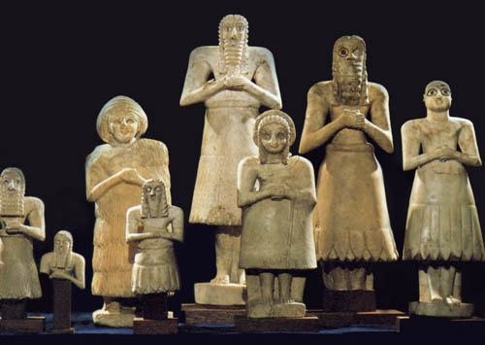
Sumerian Mythology
Sumerian myths, or stories, explained people’s beliefs. Sumerians believed that a person must keep the gods happy by going to the ziggurat and praying to them. They believed that the gods would reward them for good service. They also believed that the gods would punish the people who made them angry.
ziggurat
Gods

Slide 16
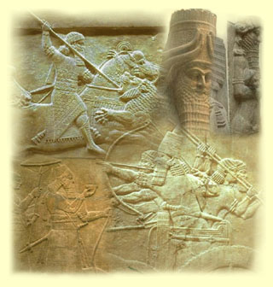
The Downfall of the Sumerians
Each of the Sumerian city-states had a ruler, and these city-states began fighting each other. They fought over land and the use of river water. Since the Sumerians were constantly at war with each other, they became weak. By 2000 BC, Sumer was a weakened area, and by 1759 BC, Sumer was conquered by another group of people - the Babylonians, who were from the north.

